Slide 1
BANGLADESH UNIVERCITY OF BUSINESS AND TECHNOLOGY (BUBT) Department of Computer Science and Engineering Final Year Project Presentation On Car Rental Website Titled: Easy Rent

Slide 2
Car Rental Website
Developed by
Md. Sharif Uddin Khan ID: 12133103004
Intake: CSE 24th
Sha Md.Arafatul Rahman ID:12133103037
Intake: CSE 24th
Md. Rocky Al Mamun ID:12132103073
Intake: CSE 23rd
Supervised by
Ms. Sheikh Tania
Assistant Professor
Dept of CSE
Bangladesh University of Business and Technology

Slide 3
Content
Introduction.
Objectives of the Project.
Technologies used.
E-R diagram.
Data flow diagram.
Use Case Diagram.
System limitations.
Future Works.
Discussion and conclusion.

Slide 4
Introduction
Easy Rent is a car rental service
Easy Rent are offering car rental and car hire making full use of information technology to improve level of efficiency
It offers the online car hire service for corporate houses
It offers the best of rates and include the different categories of cars from luxury to budget

Slide 5
Objectives of the project
Anybody can view available/Unavailable car.
Anybody can register.
Only registered user can booking car.
User can update and cancel booking.
Admin can view all booking.
Admin approve booking.
Amin can add car and user.

Slide 6
Technology Used
As our system is web based, so we have used web technologies for the development of both front end and back end.
HTML-5
CSS
Bootstrap
Java Script
jQuery
PHP
MySQL

Slide 7
E-R Diagram
An entity-relationship (ER) diagram is a specialized graphical representation that illustrates the relationships between entities in a database.

Slide 8
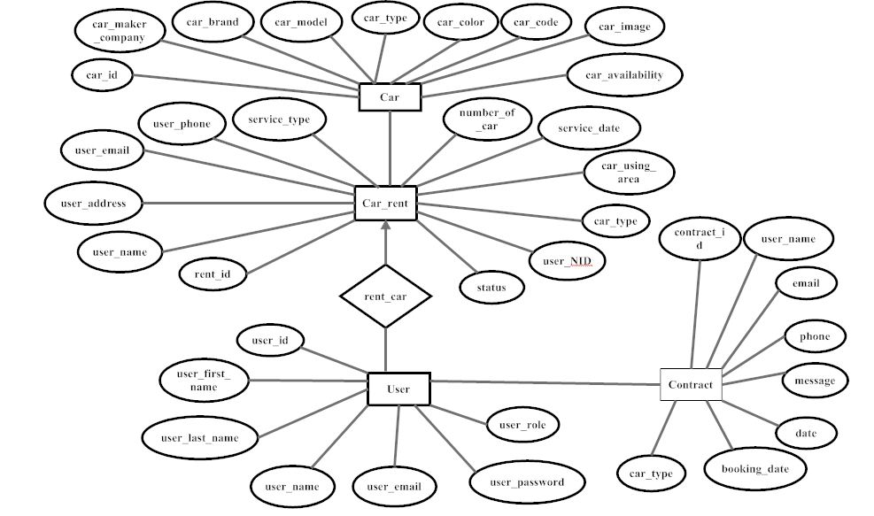
E-R Diagram (contd.)
Figure 1: E-R Diagram of Easy Rent

Slide 9
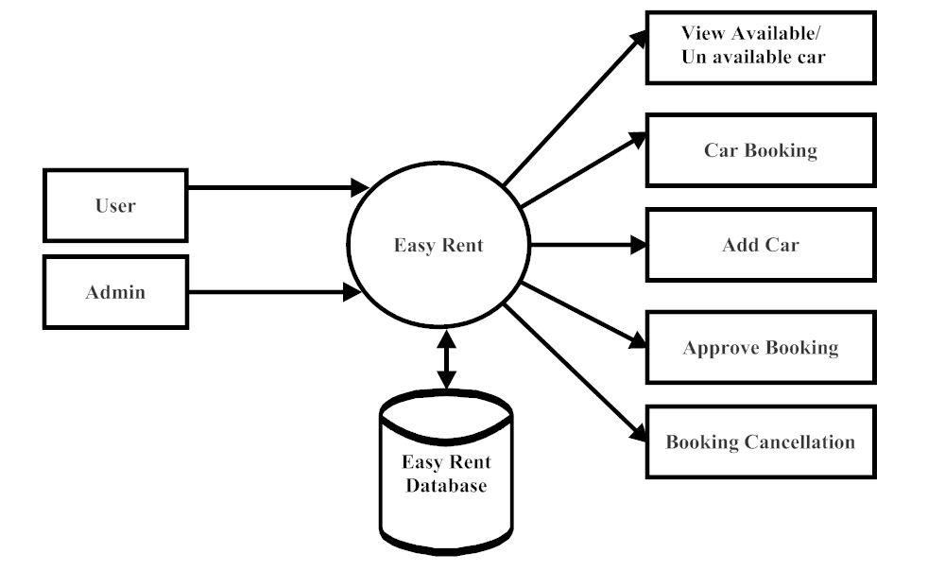
Data Flow Diagram (0 level)
Figure 2: Data Flow Diagram (0 level)

Slide 10
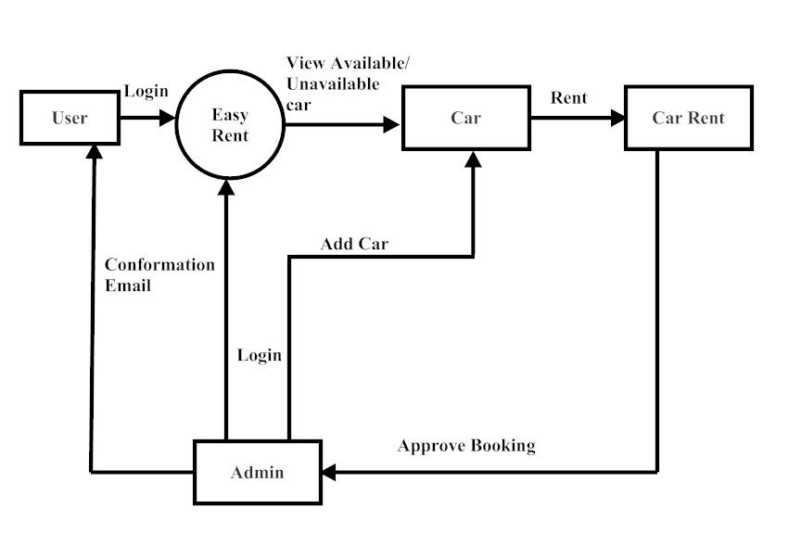
Data Flow Diagram (1 level)
Figure 3: Data Flow Diagram (1 level)

Slide 11
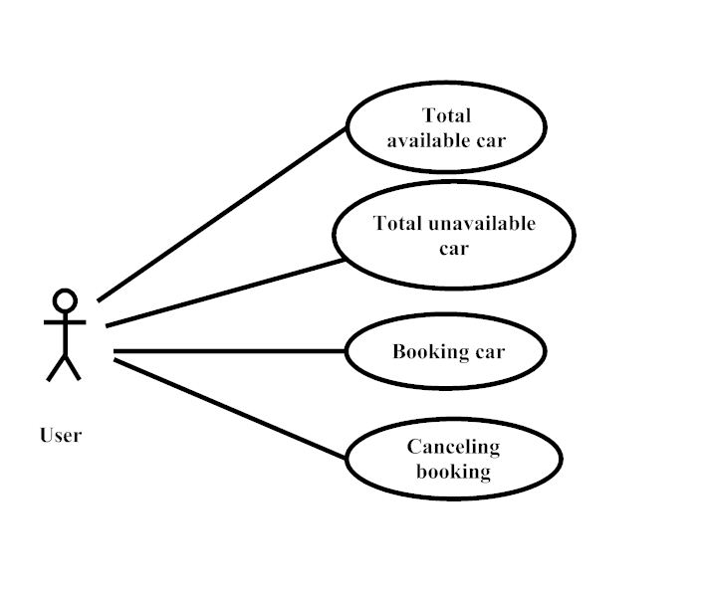
Use Case Diagram of User
Figure 4: Use Case Diagram of User

Slide 12
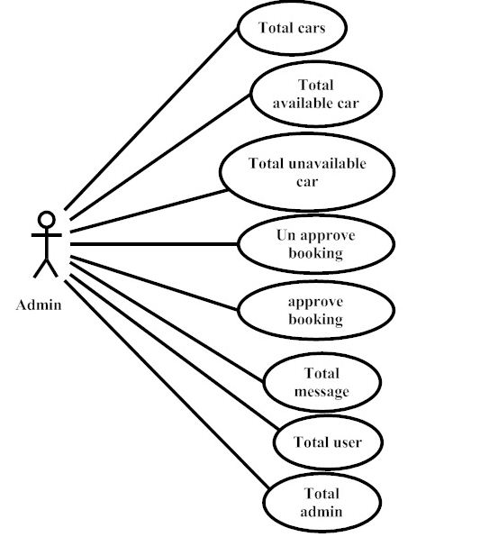
Use Case Diagram of Admin
Figure 5: Use Case Diagram of Admin

Slide 13
System Limitations
This System is developed for only personal computer.
We have no searching option, user can see available/unavailable car.
We want to increase the security level one step ahead.
Credit card validation is not done, we only support Bkash and Rocket payment by manually.

Slide 14
Future Works
A message will sent to user when we will provide a mega discount.
When user booking a car we will give discount 10-25% of total amount.
We want to show the location of car in Google map.
We will support credit card payment in near future.

Slide 15
Discussion & Conclusion
The purpose of this website to rent car in online without any hassle, we hope it will satisfy the demand of our users and make better improvement in near future. The Easy Rent has offered an advantage to booth user as well admin to effectively manage and satisfies users, just need at the click of a button.

Slide 16
Thank You

